Slide 1
Business Analytics & Business Intelligence
Jaisheel Chhatrawala
L&T Technology Services

Slide 2
What’s Special:
01
Need for Business Analyst
02
Business Analyst Roles & Responsibilities
03
Business Analyst Skills
04
Knowledge Areas
05
Business Analyst vs Data Analyst
06
Business Analytics vs Business Intelligence

Slide 3
What is Analytics?!

Slide 4
What is Analytics?!
Data
Data
Business Insights
Data

Slide 5
Our Reality
Good Data
Noise
Messy Data
Business Insights
Noise
Garbage Data

Slide 6

TYPES OF ANALYTICS
DESCRIPTIVE ANALYTICS
PREDICTIVE/PRESCRIPTIVE
What were our sales?
What was our market share?
What product was most popular?
What are the expected sales?
What is the expected market share?
What product should we market to them?

Slide 7


Need & Importance of Business Analyst
This is Jacob’s multicuisine restaurant. One of the oldest and best fine dine restaurant in a small town

Slide 8

His business went on well until the onset of COVID-19

Slide 9

After COVID-19, his business took a hit & Jacob lost many customers and revenue

Slide 10
Jacob couldn’t afford to shut down his business any longer. Hence, he was determined to find a way out

Slide 11
He had read about business analyst, who can bring revolutionary change into business model.

Slide 12

Hence, without further confusion, Jacob hired a business analyst, Robin to solve his existing business issue

Slide 13
After discussing with Jacob, Robin learned that the business objective was to get 80% of the customer back and to find a sustainable way of running the restaurant in the long tenure

Slide 14
Robin proposed new changes after a lot of brainstorming to get business up and running
Make a home delivery app for Jacob’s restaurant
Offer Special WFH meal
Provide discount coupons
Have a few restaurant staff do the food delivery

Slide 15

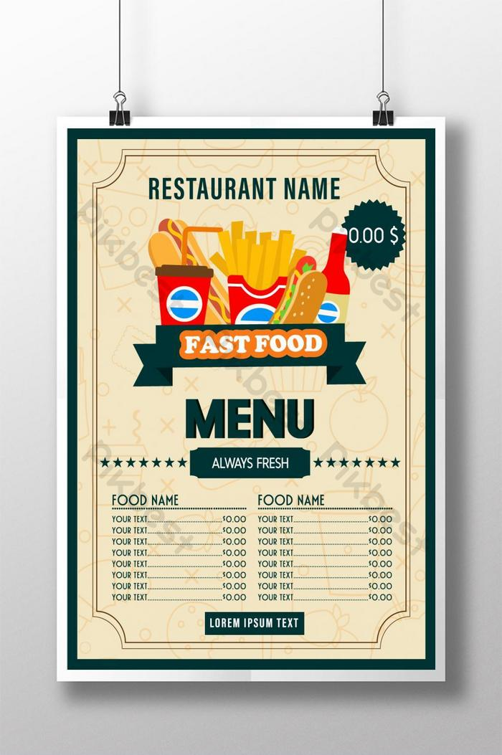
Once Jacob approved the changes and ideas, Robin started working with IT team to develop app. Also he made sure that business requirements should meet up to the mark

Slide 16


Slide 17
Continuous Consultation
Robin also supervised the implementation of other related changes and conducted regular brainstorming sessions to evaluate progress
Along with this exercise Robin has also done in-depth survey of other competitive market for better bounce back strategy

Slide 18

After the changes were implemented, Robin documented reports that gave Jacob’s business insight into the current changes

Slide 19

In the end, Robin successfully came up with changes that enabled Jacob to start his business amidst the pandemic
And that’s how Robin , the Business Analyst helped Jacob restart his business. Robin implemented a sustainable way for Jacob to carry out his business

Slide 20
1. Understand the Business Objective
Infographic Style

